Slide 1
NAAM
JavaFx : the next Java?

Slide 2
JavaFX Platform“
Created by Chris Oliver at SeeBeyond.
SeeBeyond acquired by Sun.
JavaFX Announced by Sun In December of 2008.
“Rich internet experiences for all screens of your life!”
Java Swing and Java 2D are complex.
Java FX Script is a declarative language for UI construction.
Java FX Script can use the traditional Java API but is not Java.
Java SE 6 Update 10 for automatic JRE deployment and upgrades.
Supports audio, video, graphics and web services.
Competes with MS Silverlight and Adobe Flash.
Runs as an applet or stand alone application.

Slide 3
JavaFX Tooling
JavaFX is supported in Netbeans.
See: http://netbeans.org/features/javafx/
Project management, composer, Language editor
An Eclipse plugin exists.
See: http://javafx.com/docs/gettingstarted/eclipse-plugin/
JavaFX is supported on the command line.
See: http://www.sun.com/software/javafx
Install Java FX
The JavaFX code is compiled to Java bytecode and runs on the JVM.

Slide 4
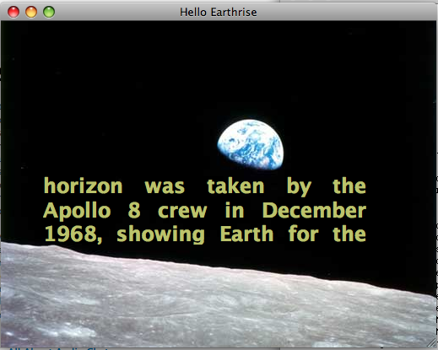
JavaFX Command Line Example
cd 95-733/proJavaFXPlatform/BookCode/Chapter01/HelloEarthRise/src/projavafx/helloearthrise/ui
Compile with $javafxc -d . HelloEarthRiseMain.fx
Execute with $javafx projavafx.helloearthrise.ui.HelloEarthRiseMain
May also be deployed
as an applet or a Java
Web Start Application.

Slide 5
Java Web Start
Based on Java Network Launching Protocol (JNLP).
Java Web Start is a JNLP client.
The client asks the server for a JNLP
file.
The client parses the file and “renders” an application by fetching any additional resources.
The client executes the application.

Slide 6
Visie
"JavaFX is a powerful client technology for creating rich Internet applications (RIAs) with immersive media and content across the multiple screens of your life"

Slide 7
James Gosling :
'Most scripting languages are oriented at banging out Web pages. This is oriented around interfaces that are highly animated'
'There are parts of the world where a person's desktop computer is their cell phone, and that's the kind of end point that we're going to get to'

Slide 8
Target
Desktop
Web
Mobile
TV
Other platforms

Slide 9
Examples
https://openjfx.dev.java.net/
Racing game
  http://a.stritzinger.googlepages.com/jfxrace
8-ball
  http://110j.wordpress.com/2008/09/07/the-8-ball-problem-have-a-try/
Viking and wizards game
  http://learnjavafx.typepad.com/weblog/2008/09/vikings-and-wizards-in-javafx.html
TableNodeExample
  http://learnjavafx.typepad.com/weblog/2008/08/tablenode-creat.html

Slide 10
Onderdelen
JavaFx script
Designer tools
Developer tools
JavaFx Mobile
Consumer JRE

Slide 11
JavaFx script
JavaFX Script is a compiled statically typed declarative scripting language for the Java Platform providing automatic data-binding, full support for 2D graphics and standard Swing components as well as declarative animation. Because it is built on top of the Java Platform, it is easy to use any Java class in JavaFX scripts.
JavaFX is able to run on any platform which has the Java Runtime installed. No modifications are needed since the JavaFX interpreter generates default Java bytecode. A compiler is planned for the future that will improve performance by compiling JavaFX directly into bytecode.
JavaFX Script's declarative syntax for constructing user interfaces contrasts sharply with the more verbose series of method calls required to construct an equivalent interface in Swing directly.

Slide 12
JavaFx script
Front end focus
  swing
  Java 2d
Statically typed
Declaratief
Interpreter genereert Java bytecode
Use Java

Slide 13
Designer tools
Project Nile
  a suite of tools and plugins
    Adobe Photoshop
    Adobe Illustrator

Slide 14
Developer tools
IDE support
  Netbeans
  [old Eclipse plugin]
SDK
[ant based examples]

Slide 15
JavaFx Mobile
JavaFX Mobile is a Java operating system for mobile devices initially developed by SavaJe Technologies
  purchased by Sun Microsystems in April 2007

Slide 16
Consumer JRE
JRE 1.6.0_10 : RC
The deployment toolkit
  Javascript and browser plugins
A new installer
the Java Kernel
  modular
Quick Starter
  small service for Windows to improve JVM launch speed
Media
  new support for video and sound, including a codec that is guaranteed to always be there
Nimbus
  cross platform look and feel
Drag and drop to desktop
  http://java.sun.com/developer/technicalArticles/javase/6u10_applets/

Slide 17
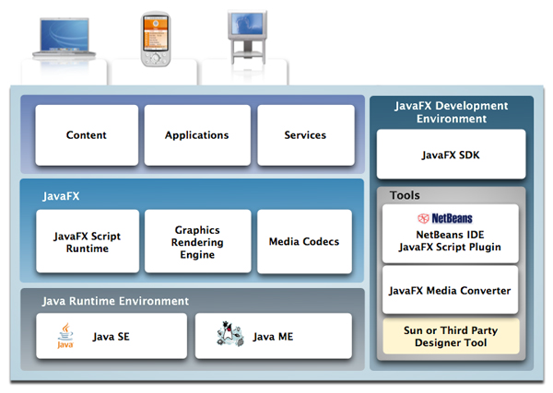

Slide 18
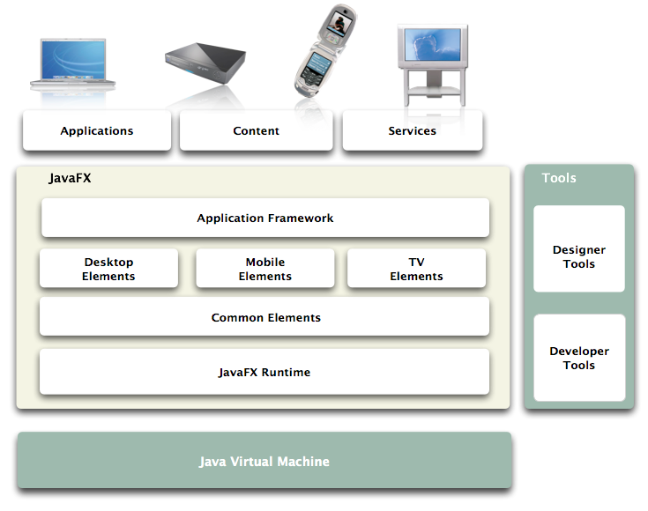

Slide 19
Cross Platform Applications:
  JavaFX Common APIs only.
    Currently : 2D Graphics, Animation and Text.
    Future : audio, video, networking, local storage and other relevant components
Desktop Applications
  desktop look and feel with the JavaFX Swing
  Device Media Frameworks and advanced graphics support

Slide 20
Licencing
The core JavaFX runtime is still Proprietary software and its code has yet not been released to the public
The JavaFX compiler and 2D Scene graph are released under a GPL v2 license,
The NetBeans plugin for JavaFX is dual licensed under GPL v2 and CDDL.

Slide 21
Example
import javafx.ext.swing.*;
SwingFrame {
title: "Hello World!";
width: 100;
height: 50;
content: Label {
text: "Hello World!";
}
visible: true;
}
import javafx.ext.swing.*;
var myFrame:SwingFrame = new SwingFrame();
var myLabel:Label = new Label();
myLabel.text = "Hello World!";
myFrame.width = 200;
myFrame.height = 50;
myFrame.visible = true;
myFrame.content = myLabel;

Slide 22
Node based vs. Component Based
You might wonder why the components for the Frame and Dialog in the previous example have the class names SwingFrame and SwingDialog rather than simply Frame and Dialog. The answer is related to a future where JavaFX Script developers will build UIs using a node-based approach rather than the traditional approach of using a hierarchy of Swing-based components. In fact, initial support for that future approach is already in the JavaFX libraries. For example, the javafx.application package includes classes such as Frame, Dialog, and Window that support the node-based approach. To avoid confusion between the classes that support the different approaches, the prefix "Swing" was added to the names of the classes in the javafx.ext.swing package that have counterparts in the javafx.application package.

Slide 23
SDK
NetBeans
  <install dir>/javafx/javafx-sdk1.0pre1
Standalone

Slide 24
Contents
bin
  javafx
  javafxc
  javafxdoc
doc
lib
samples
src.zip

Slide 25
Getting started
sdk samples
NetBeans -> New Project -> samples -> JavaFx

Slide 26
Library overview
javafx.animation
javafx.application
javafx.ext.swing
javafx.input
javafx.lang
javafx.scene
javafx.scene.effect
javafx.scene.effect.light
javafx.scene.geometry
javafx.scene.image
javafx.scene.layout
javafx.scene.media
javafx.scene.paint
javafx.scene.text
javafx.scene.transform
javafx.util

Slide 27
Demo's
HelloWorld
Draggable
HelloWorld applet
Simple applet
Create

Slide 28
JavaFxDoc
Uitbreiding op JavaDoc

Slide 29
Issues
Preview
implementation changed this year
  sdk package structure
  operation -> function
  attributes
  ...
Limited implementation
Netbeans preview applet code

Slide 30
Getting started
http://java.sun.com/developer/technicalArticles/scripting/javafx/lc/part1/

Slide 31
Workshop
http://java.sun.com/javafx/tutorials/simple_javafx_nb_app/
http://java.sun.com/javafx/reference/creating_guis/

Slide 32
References
http://javafx.com/
http://weblogs.java.net/blog/joshy/archive/2007/09/javafx_javafx_s.html
https://openjfx.dev.java.net/
  code, documentation and demos

